Slide 1

Life expectancy improvement project
Group 2:
Fawad Khan, Divya Thailam, Reshma Madhuri, Pravalika Vulimiri, Naga Adithya Kaushik Chandrabhatla
Notes:
NOTE:
To change the image on this slide, select the picture and delete it. Then click the Pictures icon in the placeholder to insert your own image.

Slide 2
Table of contents
Research objective(s)
Research questions & hypothesis
Literature review
Research methods
Data analysis
Research discussion
Conclusion

Slide 3
Research Objective
Life expectancy project focuses on improving human mortality rates in developing nations. The goal is to find ways to improve daily life of citizens in Asian countries so their mortality rates can increase. In general, life expectancy can be improved by a range of factors including access to healthcare, adult mortality, socioeconomic conditions, GDP and population demographics. By working to improve these factors countries can help their citizens live longer and healthier lives.

Slide 4
Research Questions & Hypothesis
Questions:
What are the factors that impact life expectancy in Asia and why?
Which country has the highest life expectancy rate overall and why?
Hypothesis:
Higher GDP per capita is associated with a longer life expectancy in a population.
Null Hypothesis: There is no significant relationship between GDP per capita and life expectancy.
Alternative Hypothesis: A higher GDP per capita is associated with a longer life expectancy in a population.

Slide 5
Literature Review
Factors Affecting Life Expectancy: Evidence From 1980-2009 Data in Singapore, Malaysia, and Thailand
On life expectancy in Singapore, Malaysia, and Thailand, the authors want to investigate the effects of demographic shifts, socioeconomic disparity, and the availability of healthcare resources.
From 1980 to 2008, this cross-country study gathered yearly data from three Southeast Asian nations. The dependent variable is life expectancy, and the three key factors are demography, socioeconomic position, and access to health care. The results of a structural equation model demonstrate that higher levels of socioeconomic advantages and the availability of more healthcare resources are more likely to increase life expectancy. Contrarily, demographic changes have a higher likelihood of raising it through the resources for health care.
The authors propose that greater efforts should be made to broaden and enhance the coverage of healthcare programs in order to reduce regional variations in the use of healthcare and enhance the general health of people in these three Southeast Asian nations.

Slide 6
Literature Review Continued
Prediction Of Life Expectancy For Asian Population Using Machine Learning Algorithm
This study used data mining approaches to classify life expectancy for the Asian population and found that the Random Forest classifier performed better in terms of accuracy compared to other tree classifier models. The study also identified several attributes that strongly correlate with life expectancy, including economic and educational status, health conditions, and infectious diseases. The authors suggest further exploration of these correlations, particularly in light of the COVID-19 pandemic, and recommend country-based analyses to account for varying economic and healthcare situations. Additionally, they suggest comparing the results of different algorithms such as artificial neural networks, support vector machines, or logistic regression.

Slide 7
Literature Review Continued
The impact of increasing education levels on rising life expectancy: a decomposition analysis for Italy, Denmark, and the USA
This study analyzed the relationship between changes in education levels and life expectancy at age 30 in Italy, Denmark, and the USA between 1990 and 2011. The study found that changes in education levels played a significant role in the increase in life expectancy, with changes in educational attainment accounting for between 15% and 40% of the increase in life expectancy.
The study also found that life expectancy was highest for those with more than a high school education and that the gap in life expectancy between different education levels increased over the two decades studied.
The study's contribution lies in its use of data from three countries with different education profiles and health statuses, as well as its inclusion of more recent years in the analysis.

Slide 8
Research Method
Data: Collected from WHO (World Health Organization) website on life expectancy, also found on Kaggle.
Participants: This dataset includes data related to life expectancy of the population from year 2000 to 2015 given by the United Nations website. It consists of 22 columns and 2938 rows.
Measures:
Dependant variable: Life Expectancy
Independent variables: Adult Mortality, Infant Deaths, Alcohol, Percentage Expenditure, Hepatitis B, Measles, BMI, Polio, Diphtheria, HIV/AIDS, Thinness 1-19, Thinness under 5
Dependant variable: GDP
Independent variables: Income Composition of Resources, Population, Total Expenditure, Percentage expenditure

Slide 9
Research Method: Data Description
Column Name | Variable Name | Data Description
Country | country | Names of different countries
Year | year | Year recorded between 2000 and 2015
Status | status | Development status of the country
Life Expectancy | lifeExp | Expected age of life in numbers
Adult Mortality | adMortality | Adult Mortality Rates of both sexes (probability of dying between 15 and 60 years per 1000 population)
Infant Deaths | infDeaths | Number of Infant Deaths per 1000 population
Alcohol | alcohol | Alcohol, recorded per capita (15+) consumption (in litres of pure alcohol)
Percentage Expenditure | expdPercent | Expenditure on health as a percentage of Gross Domestic Product per capita (%)
Hepatitis B | hepB | Hepatitis B (HepB) immunization coverage among 1-year-olds (%)
Measles | measles | Number of reported cases per 1000 population
Body Mass Index | bmi | Body Mass Index per 1000 population
Under-five deaths | under5Deaths | Number of under five-deaths per 1000 population
Polio | polio | Reported Polio deaths per 1000 population
Total Expenditure | expdTotal | Total Expenditure for the given country in that year
Diptheria | diptheria | Reported Diphtheria cases per 1000 population
HIV/AIDS | hivAids | Reported HIV/AIDS cases per 1000 population
Gross Domestic Product | gdp | Gross Domestic Product for the given country in that year
Population | population | Number of populations for a country
Thinness 1-19 years | thin1_19 | Rate of Thinness of population between 1-19 years
Thinness 5-9 years | thin5_9 | Rate of Thinness of population between 5-9 years
Income composition of resources | income | Rate of income
Schooling | school | Rate of population attending school

Slide 10
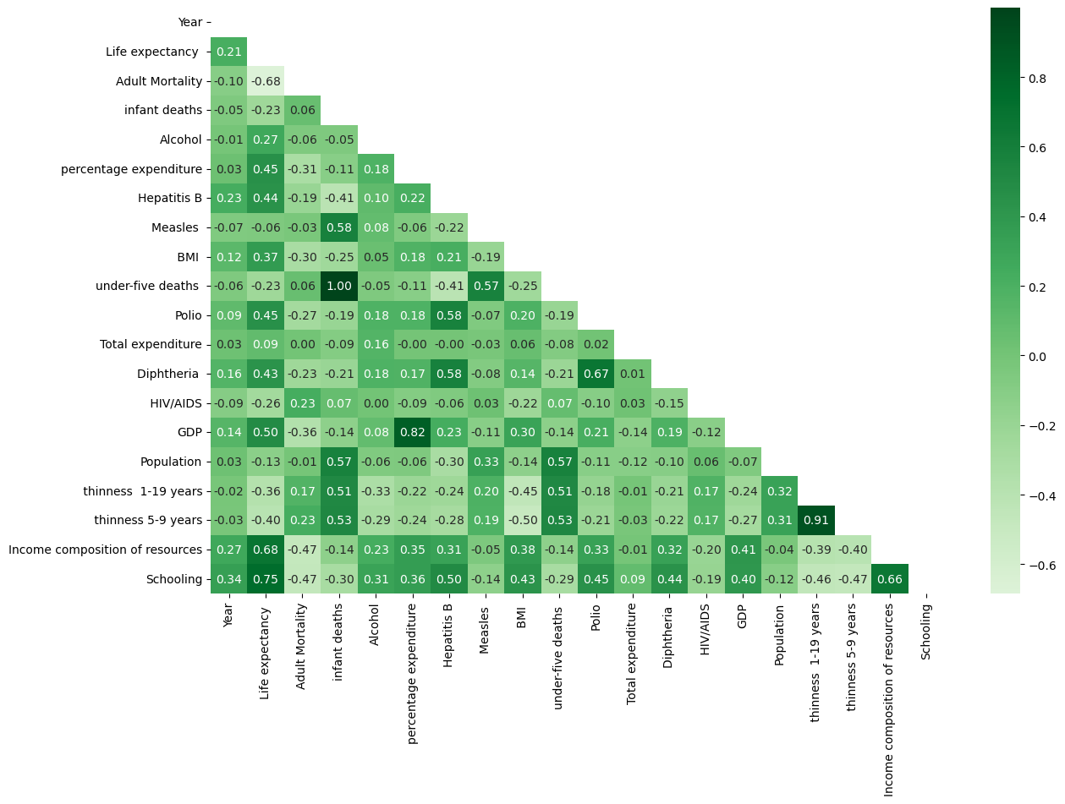
Research Method: Exploratory Analysis
Life expectancy is positively correlated with income composition of resources (0.680) and schooling (0.747), and negatively correlated with adult mortality (-0.684) and thinness 5-9 years (-0.397).
Adult mortality is negatively correlated with life expectancy (-0.684), Hepatitis B immunization coverage (-0.191), and income composition of resources (-0.475).
Infant deaths are positively correlated with under-five deaths (0.999) and thinness 1-19 years (0.513), and negatively correlated with life expectancy (-0.234) and Hepatitis B immunization coverage (-0.409).
Alcohol consumption per capita is positively correlated with life expectancy (0.268) and schooling (0.306), and negatively correlated with thinness 1-19 years (-0.326) and thinness 5-9 years (-0.291).
Percentage expenditure on health is positively correlated with life expectancy (0.455), Hepatitis B immunization coverage (0.215), and GDP (0.822).

Slide 11
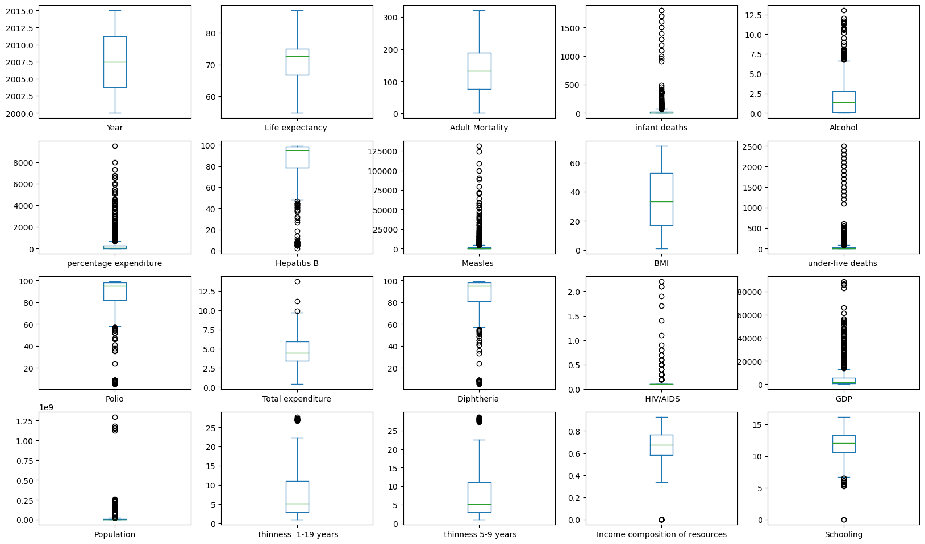
Research Method: Exploratory Analysis
As it can be observed from the box plots, there are many outliers in almost all the attributes, so we apply a standard scaler in python to standardize the data so we can proceed with our technical data analysis.

Slide 12
Research Method Continued
Technical Analysis:
Linear Regression:
Random Forest Regression
KNN Regressor
Decision Tree

Slide 13
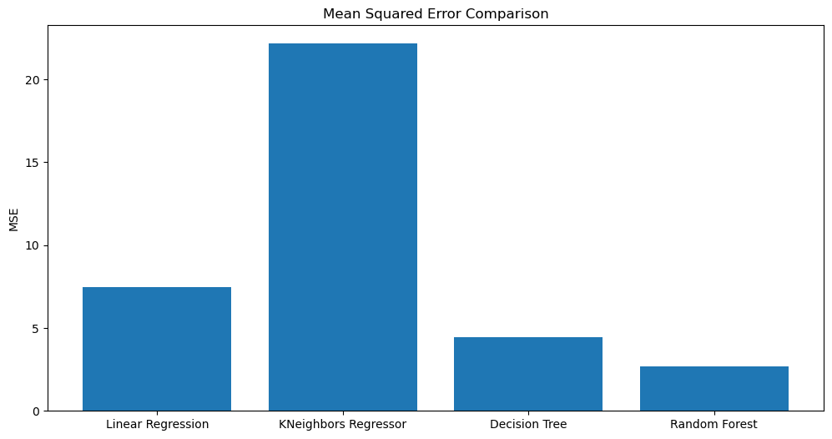
Data Analysis
As we can observe from the chart, Random Forrest has the lowest Mean Squared error value.
Random Forrest: 2.70
Decision Tree: 4.45
Linear Regression: 7.45
Kneighbors Regressor: 22.15

Slide 14
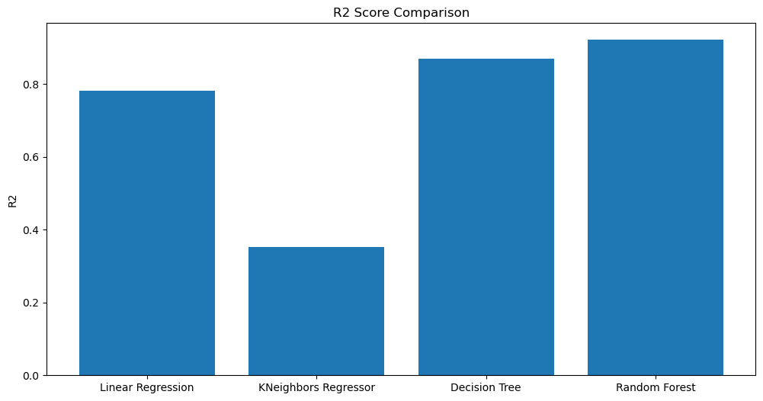
Data Analysis Continued
Random Forest has the highest R2 value.
Random Forest: 0.92
Decision Tree: 0.86
Linear Regression: 0.78
Kneighbors Regressor: 0.35

Slide 15
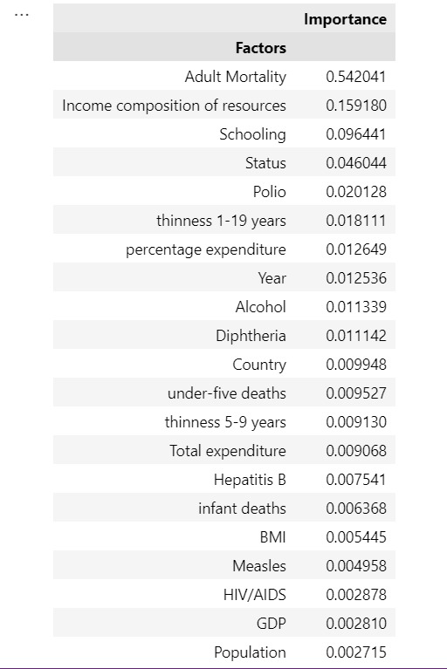
Data Analysis Continued
Adult mortality is most important factor affecting life expectancy
Working conditions in third world countries severely effect adult mortality rates
We used a feature in Random Forrest called “Importance”, which calculated the decrease in node impunity weighted by the probability of reaching that node. The node probability can be calculated by the number of samples that reach the node divided by total number of samples. The higher the value the more important the feature is.

Slide 16
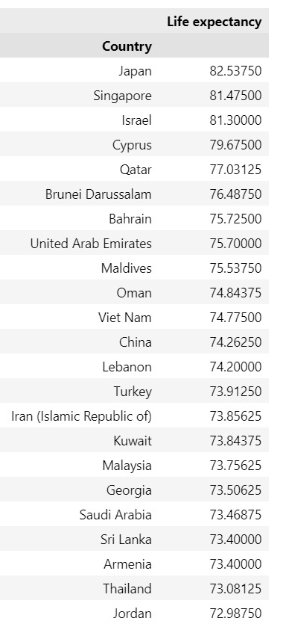
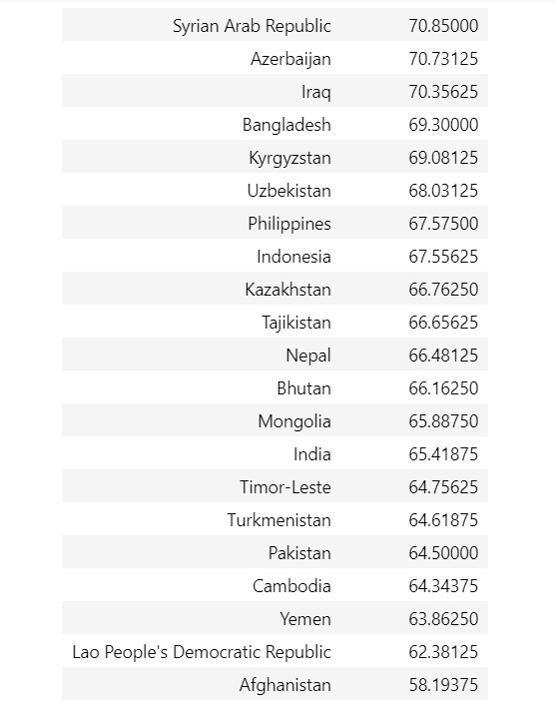
Data Analysis Continued
Japan has the highest life expectancy rate overall.
Japan has one of the lowest adult mortality rates in Asia
Japan has very few infant deaths
Japan’s schooling is one of the top schooling in Asia

Slide 17
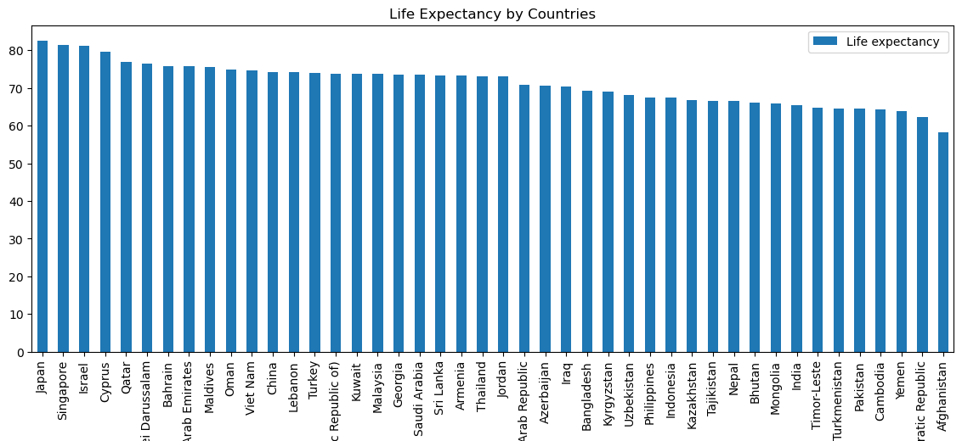
Data Analysis: Life Expectancy by Countries in Asia and Middle East

Slide 18
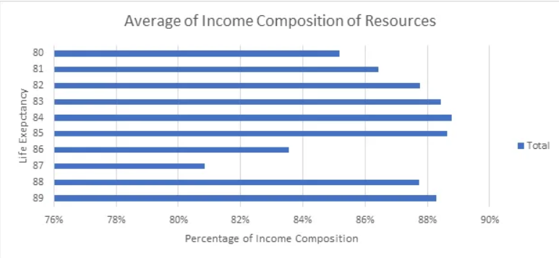
Data Analysis: Life Expectancy and Income composition of Resources

Slide 19
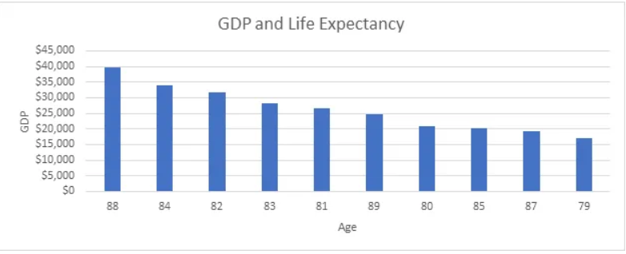
Data Analysis Continued
From the bar chart, it can be observed that higher GDP per capita shows a significant increase in life expectancy.

Slide 20
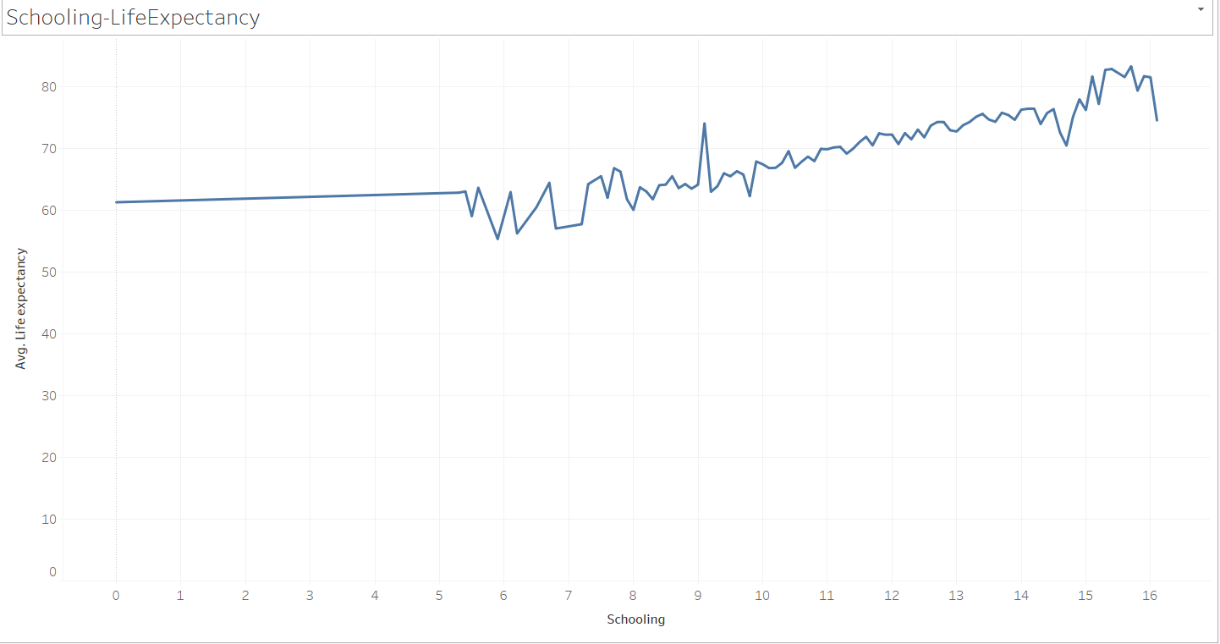
Data Analysis Continued
We can observe from the graph that life expectancy significantly increases with increase in schooling.
16 years of schooling has shown to have the highest average life expectancy while no schooling has shown the lowest average life expectancy.
We can presume from the data that schooling plays a major role in prolonging life expectancy of people, along with healthy life expectancy.

Slide 21
Research Discussion
Summary: In this research, we are focusing on how to improve life expectancy in developing countries in Asia. Developing countries tend to have socioeconomic issues, healthcare issues, adult mortality, and education to better themselves. In our analysis, we have adult mortality, education and healthcare play important role in predicting life expectancy.
Limitations:
Time:
Resources:

Slide 22
Conclusion
In conclusion, it is quite evident from our analysis that adult mortality, lifestyle, income, health coverage, education play a crucial role in a population’s life expectancy. It is important in today’s world that elected leaders should be taking steps in the right direction based on evidence, data and facts so the respective populations have access to the right resources on time. We also rejected the null hypothesis, which means that higher GDP per capita does in fact have a positive impact on healthy life expectancies of people, as also shown in the analysis, schooling and the correct income composition of resources has proved to increase life expectancies in many countries worldwide.

Slide 23
Work Citation
Chan, M. F., & Kamala Devi, M. (2012). Factors Affecting Life Expectancy. Asia Pacific Journal of Public Health, 27(2), 136–146. https://doi.org/10.1177/1010539512454163
Luy, M., Zannella, M., Wegner-Siegmundt, C., Minagawa, Y., Lutz, W., & Caselli, G. (2019). The impact of increasing education levels on rising life expectancy: a decomposition analysis for Italy, Denmark, and the USA. Genus, 75(1). https://doi.org/10.1186/s41118-019-0055-0
Pisal, N. S., Abdul-Rahman, S., Hanafiah, M., & Kamarudin, S. I. (2022). Prediction of Life Expectancy for Asian Population Using Machine Learning Algorithms. Malaysian Journal Management System; Malaysian Journal of Computing. https://myjms.mohe.gov.my/index.php/mjoc/article/view/18218/10716

Slide 24
Questions

